Slide 1
Cirq

Slide 2

Cirq
An open source quantum programming framework released in July, 2022
Designed for quantum algorithms and programs for noisy intermediate scale quantum (NISQ) devices
Users can simulate their quantum circuits on their local machines
Components are well modularized and highly encapsulated
Also used in Google’s quantum machine learning framework: TensorFlow Quantum (TFQ)

Slide 3
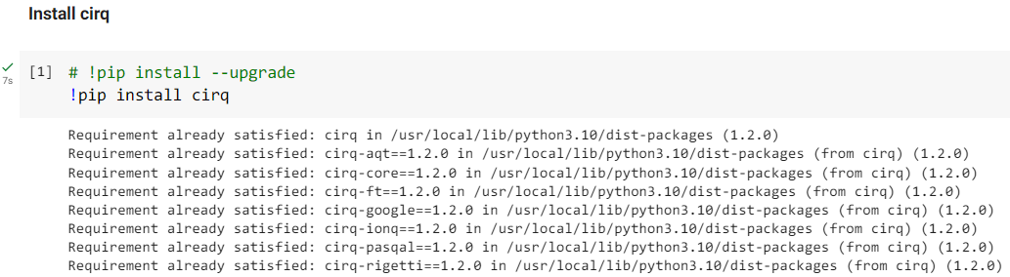
Install Cirq
Cirq is not included in the Google Colab’s built-in libraries, so we need to install it by ourselves.
If you want to install it on your machine locally, we suggest you to install it in virtual environment to prevent possible package conflicts.

Slide 4
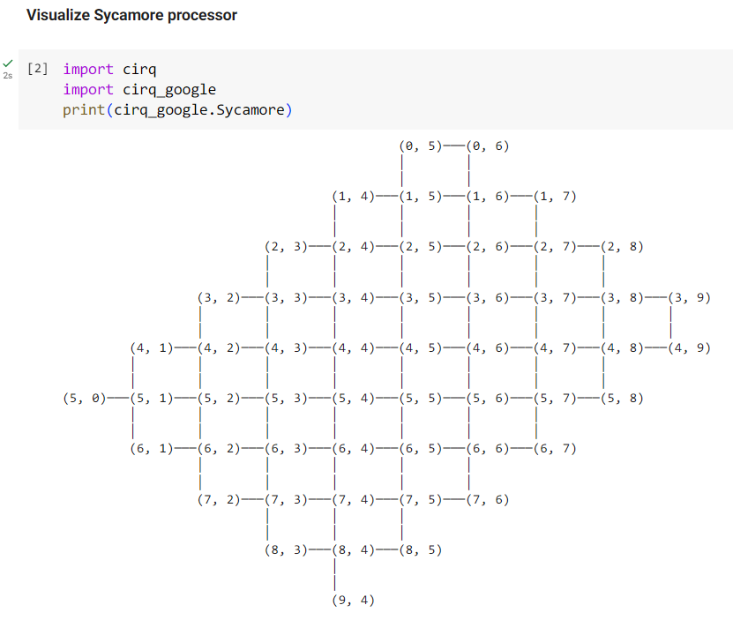
Sycamore Processor
Print the Sycamore processor using “cirq_google.Sycamore”
to see if Cirq is installed successfully.
The layout of the processor shows the structure of the device
and the connectivity of the qubits.
In real quantum computer, some operations required the
qubits to be adjacent, and this is simulated by this chip
architecture.

Slide 5
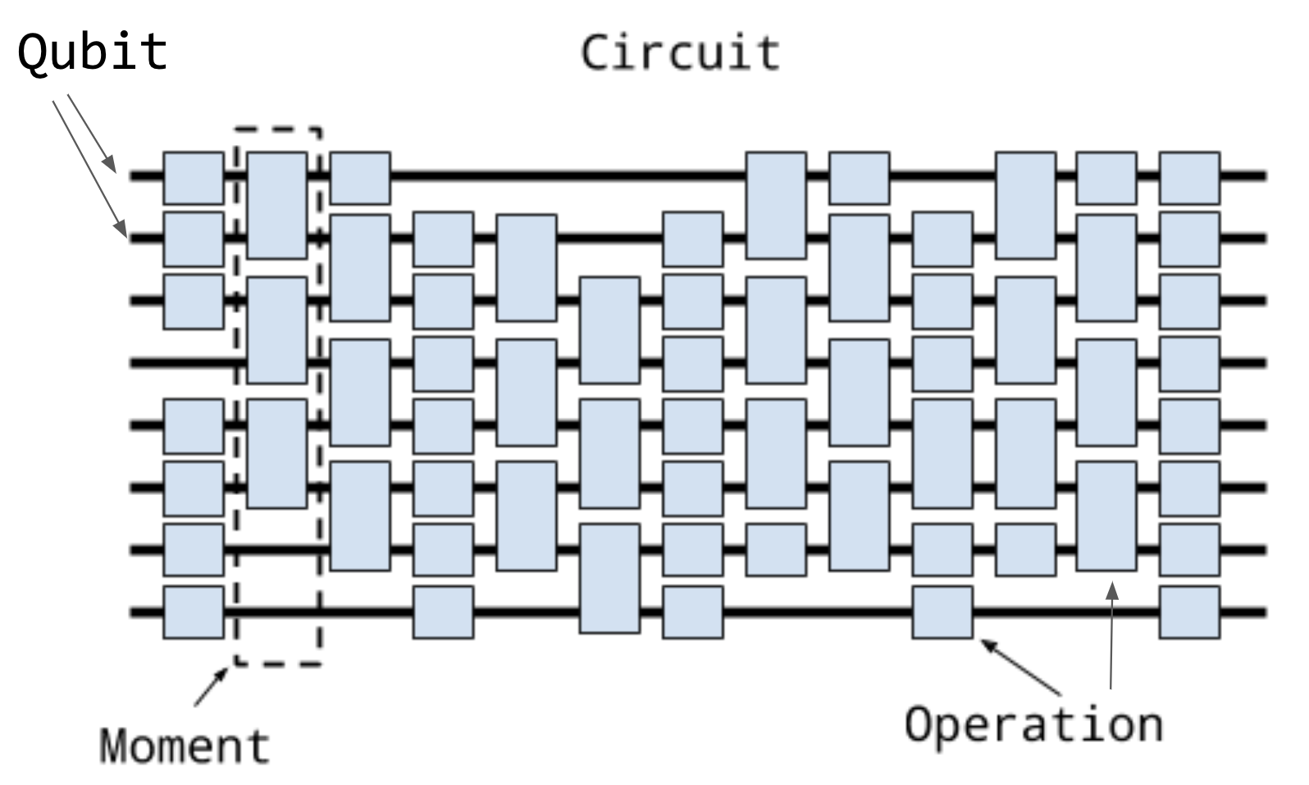
Cirq Concept
A quantum circuit consists of three parts:
Qubit
Moment
Operation
A horizontal Line with blocks represents a Qubit and the sequence of quantum gates performed on it.
Each Moment is a collection of Operations on Quibts in a time slice.
An Operation can be seen as a result of applying a Gate to Qubits.
https://quantumai.google/cirq/build/circuits

Slide 6
Qubit
Qubit, an abbreviation of quantum bit, is a basic unit of quantum information.
To operate the qubits using a quantum circuit, we need to specify the qubits we want to use by their coordinates.
NamedQubit: A named qubit, its coordinate is arranged automatically
LineQubit: A qubit on 1d lattice, its y coordinate is arranged automatically
GridQubit: A qubit on a square lattice
If you only need a few qubits, use NamedQubit.
If your need neighboring qubits for a circuits with many multi-qubit operations, GridQubit is what you need.

Slide 7
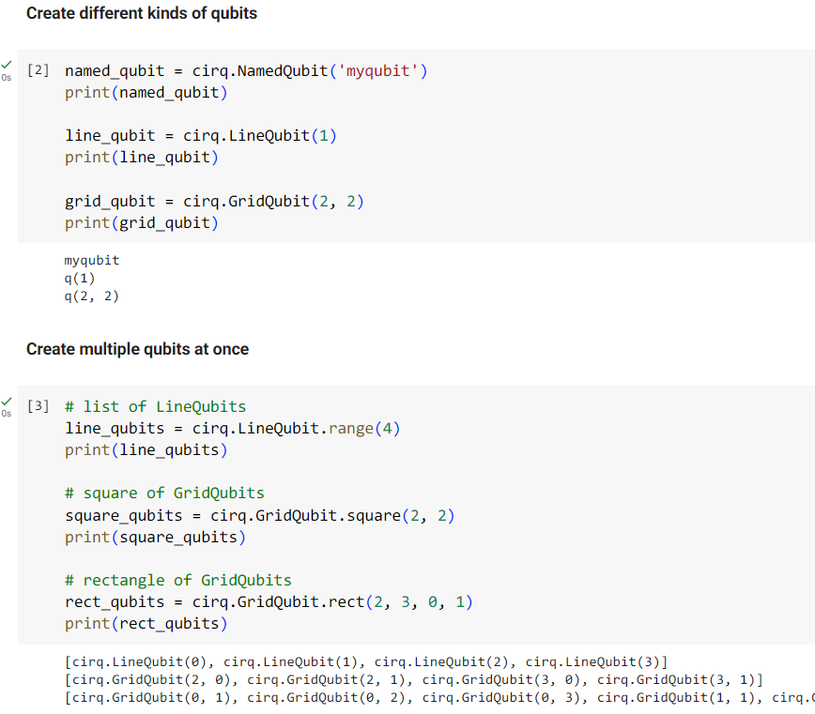
Qubit
A single qubit can be created by passing either
coordinates or a name to the constructor.
We can specify the length of the side, the starting
row number and column number to create a square
of qubits (all of which are set to 0 by default).
For rectangle of qubits, four arguments are required:
the number of rows and columns, as well as the
starting row and column numbers.

Slide 8
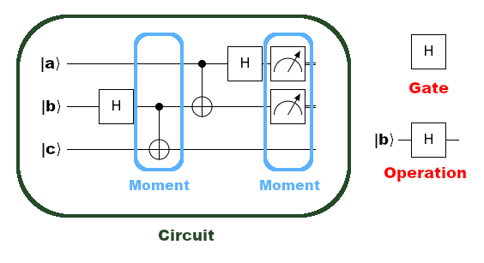
Gate and Operation
A Gate object represents a static quantum gate, which is a 2^n by 2^n dimensional invertible linear operator.
After applied to one or more Qubits, a Gate will generate a GateOperation corresponding to those qubits.
https://quantumai.google/cirq/images/moments.png

Slide 9
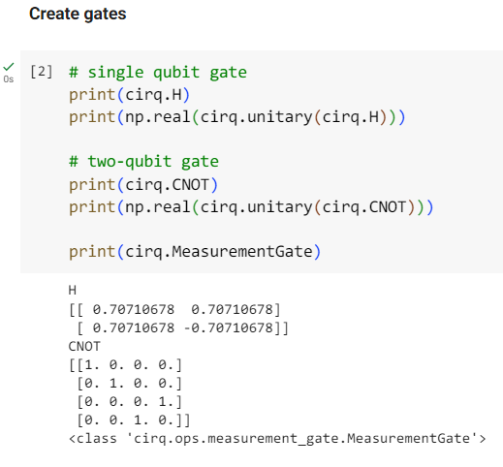
Gate and Operation
The unitary matrix of a quantum gate can be
accessed by cirq.unitary(Gate).
Using np.real(), we extract the real part of the
complex matrix to simplify the outcome.
An measurement operation is non-invertible, thus
it doesn’t have a unitary representation.

Slide 10
Moment
Operations are executed from left to right, and Operations
on the same column must be executed simultaneously,
even if they have different durations.
As a result, each column is encapsulated as a Moment
object to enhance programmability and facilitate execution.
Using this architecture, we can insert the Operations into a
Momenet one by one and then add it to the existing circuit.
https://quantumai.google/cirq/build/circuits

Slide 11
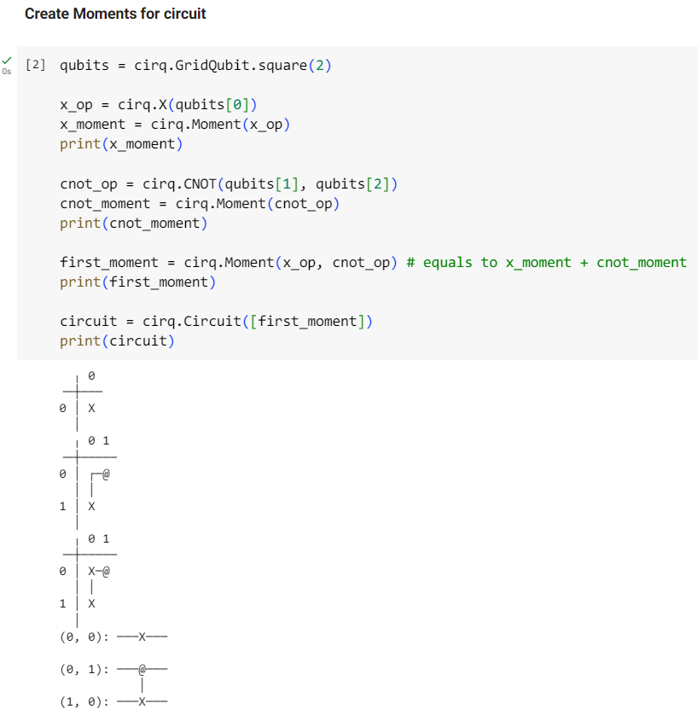
Moment
A Moment is created using cirq.Moment(op1, op2, …).
The row and column represent a qubit’s x and y coordinates,
while the lines show the connectivity.
Then we create an empty circuit with cirq.Circuit() and add
the Moment to visualize it.
Since the qubits used by different operations do not overlap,
they can be placed in the same moment of circuit.

Slide 12
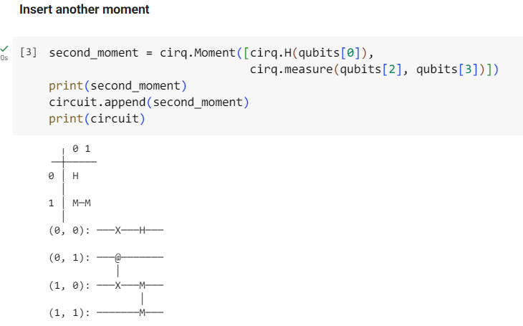
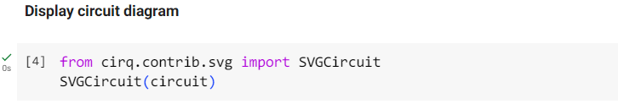
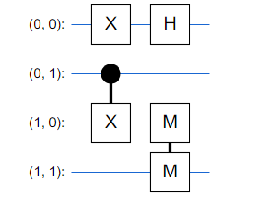
Moment
You can add a Moment to a Circuit as a column using a
circuit instance’s append() method.
SVGCircuit(Circuit) will display the circuit in a “prettier” way,
replacing gates with widely-used quantum gate symbols.

Slide 13
Circuit: Insertion Strategy
A Circuit can also be constructed from a list of Operations, which will be
arranged into different Moments based on the circuit’s insertion strategy:
EARLIEST: Add to the earliest Moment if there is an available space
INLINE: Insert into the previous Moment if possible, otherwise, or create a new Moment
NEW: Create a new Moment for each new Operation
NEW_THEN_INLINE: Create a new Moment for the first Operation and insert the rest based on INLINE strategy

Slide 14
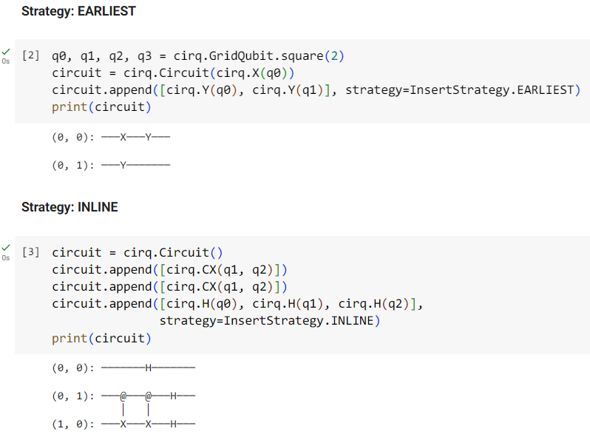
Circuit: Insertion Strategy
In the first case, the Y operation on the second qubit
slides back to the first Moment.
Because the CX Operation occupies the second and third
qubits in the second Moment, a new Moment is then
created for the remaining Hadamard Operations.
https://quantumai.google/cirq/build/circuits

Slide 15
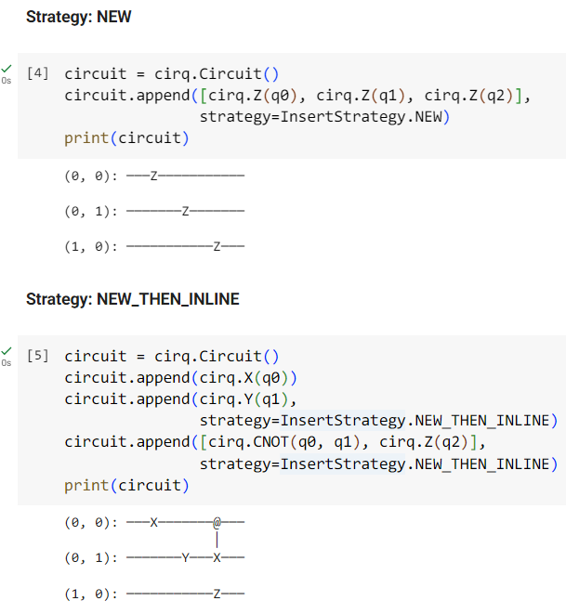
Circuit: Insertion Strategy
Each Pauli-Z Operation is appended as a distinct Moment.
A new Moment is created for the Pauli-Y and CNOT Operation,
and the last Pauli-Z Operation is inserted into the same
Moment based on INLINE strategy.
https://quantumai.google/cirq/build/circuits

Slide 16
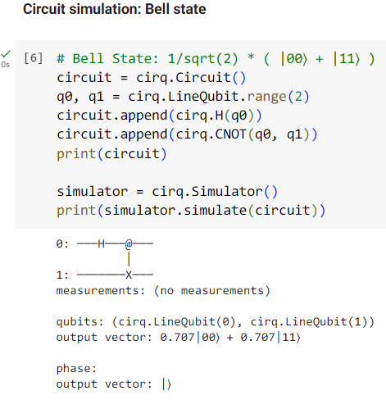
Circuit: Simulation
The Bell state is the simplest example of quantum entanglement,
containing a Hadamard gate and a CNOT gate.
We initialize a simulator instance using cirq.Simulator(), and call
the simulate() function to compute the circuit’s resulting state.
https://quantumai.google/cirq/build/circuits

Slide 17
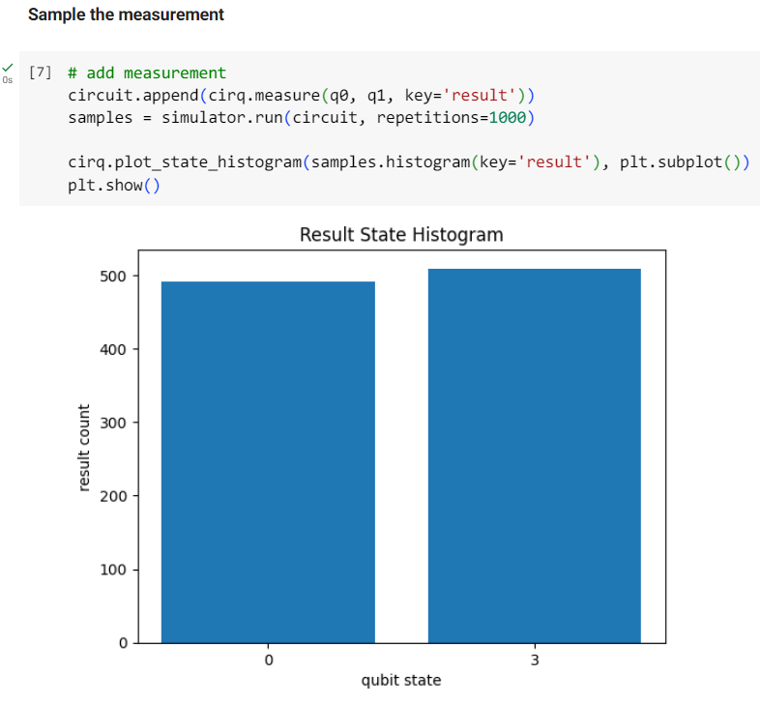
Circuit Simulation
To sample the distribution of result after computation, a
measurement gate is required.
Calling simulator.run(circuit, repetitions=1000) will return the
result of executing the circuit 1000 times as bitstring.
The bitstring is visualized using cirq.plot_state_histogram(), and
we can observe that the state |00> and |11> have almost an
equal probability of occurrence.

Slide 18
Sources
“Cirq Basics” by Google Quantum AI: https://quantumai.google/cirq/start/basics
“Cirq Builds” by Google Quantum AI: https://quantumai.google/cirq/build
Cirq API Document: https://quantumai.google/reference/python/cirq/all_symbols

